Slide 1
Ultrasonic Sensor Interfacing
Vy. N – C0776242 – Group 1

Slide 2
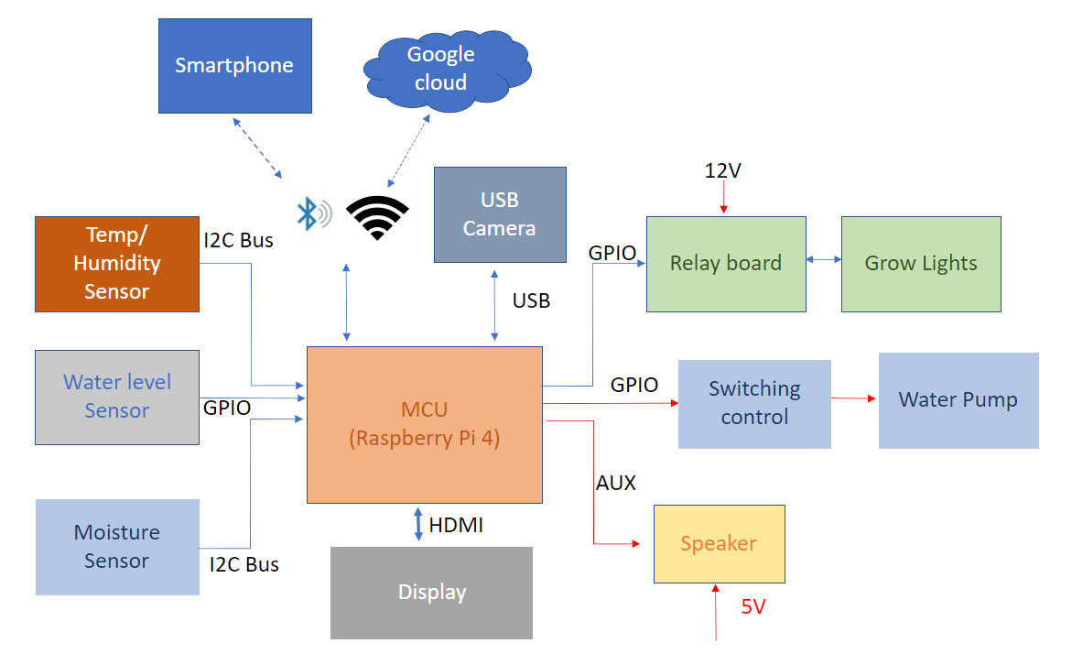
Project summary – Block diagram

Slide 3
Project Summary – Key features
Smartphone control: the device can be monitored and controlled via the BLE system or by smartphone via Wifi and Google Cloud.
Auto-adjusting temperature: with an optional enclosed space, the temperature in each slot of the device can be adjusted to a suitable level for any particular plant.
Auto-adjusting humidity: some plants may enjoy their habitat in a humid environment; our device can replicate the humidifier system’s moist air humidifier system’s moist air-control.
Auto-watering: the plants will never be dried out again with this feature; the device will detect the soil’s humidity and automatically water your plants whenever they need.
Auto-disease-detect: the device will have a camera system that scans the leaves of your plants, then detects any disease happening to the plants, and recommends proper treatment.
Light system: with the LEDs system, the device can save up to 70% of power consumption.
Music player: yes, our device will also have a music function. You wonder why? According to a study, music increases plants’ productivity, and it improves their health and “mood.” (Mazlan, 2020).
Friendly control interface: With a touch screen built on, you can easily control your whole garden within a few steps.

Slide 4
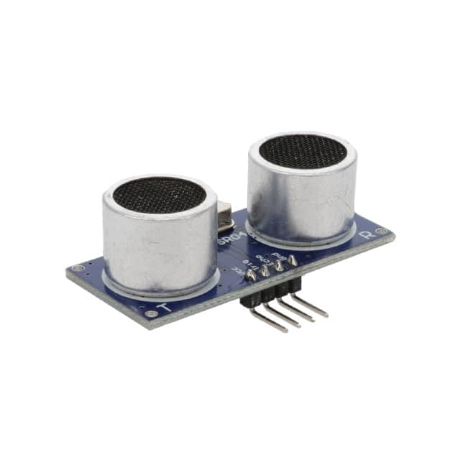
Ultrasonic sensor - Introduction
Introduction:
Ultrasonic ranging module HC - SR04 provides 2cm - 400cm non-contact measurement function, the ranging accuracy can reach to 3mm. The modules includes ultrasonic transmitters, receiver and control circuit.

Slide 5
Ultrasonic sensor - Specifications
Specifications:
Working Voltage | DC 5 V
Working Current | 15mA
Working Frequency | 40Hz
Max Range | 4m
Min Range | 2cm
Measuring Angle | 15 degree
Trigger Input Signal | 10uS TTL pulse
Echo Output Signal | Input TTL lever signal and the range in proportion
Dimension | 45*20*15mm

Slide 6
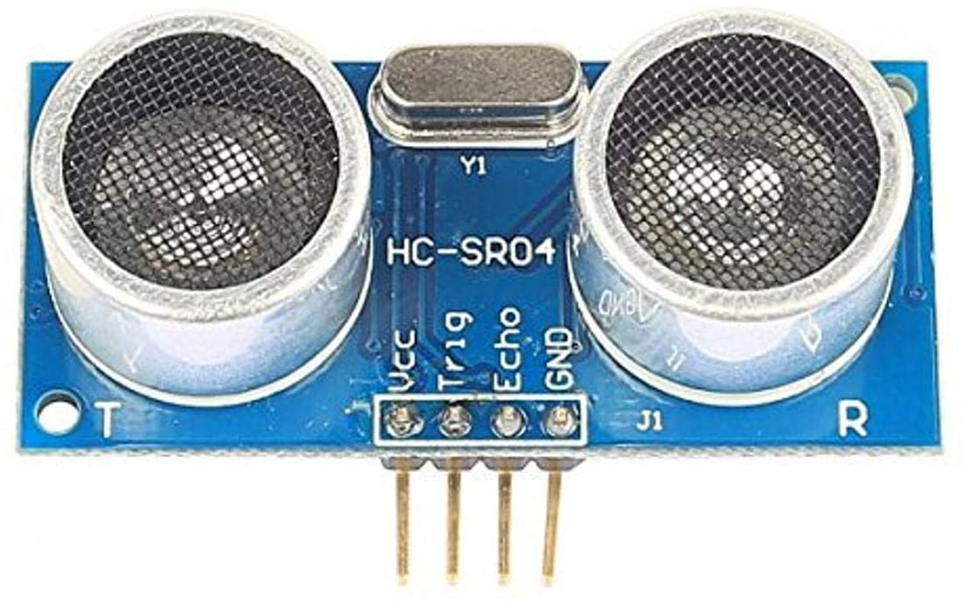
Ultrasonic sensor – Wire Connection
Wire Connection
5V Supply
Trigger Pulse Input
Echo Pulse Output
Ground

Slide 7
Ultrasonic sensor – Working Principles
Using IO trigger for at least 10us high level signal,
The Module automatically sends eight 40 kHz and detect whether there is a pulse signal back.
IF the signal back, through high level , time of high output IO duration is the time from sending ultrasonic to returning.
Test distance = (high level time × velocity of sound (340M/S) / 2

Slide 8
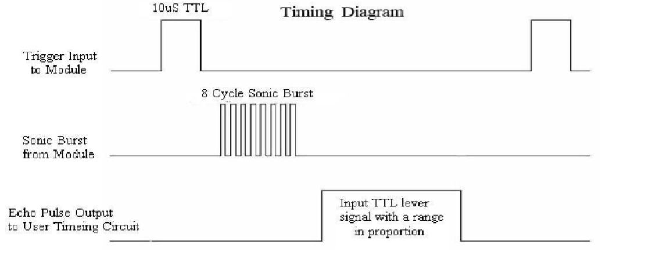
Ultrasonic sensor – Timing Diagram
You only need to supply a short 10uS pulse to the trigger input to start the ranging.
The module will send out an 8 cycle burst of ultrasound at 40 kHz and raise its echo.
The Echo is a distance object that is pulse width and the range in proportion .

Slide 9
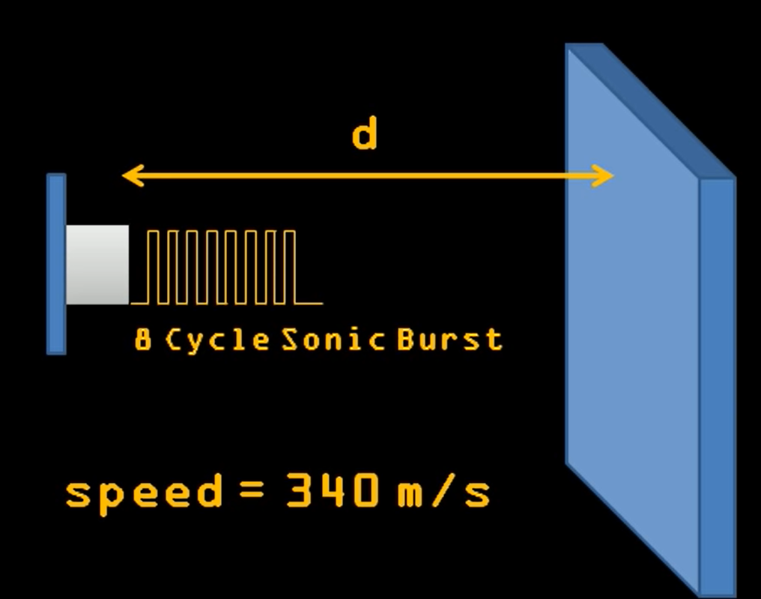
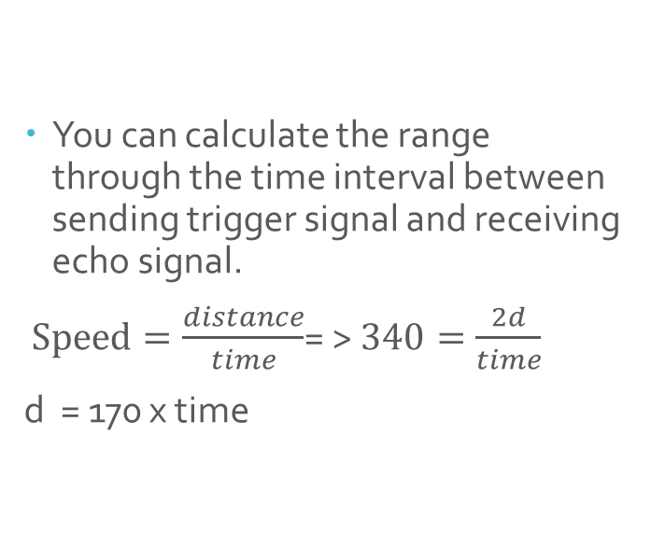
Ultrasonic sensor – Calculation Distance
You can calculate the range through the time interval between sending trigger signal and receiving echo signal.
$Speed=\frac{distance}{time}$= > $340=\frac{2d}{time}$
d = 170 x time

Slide 10
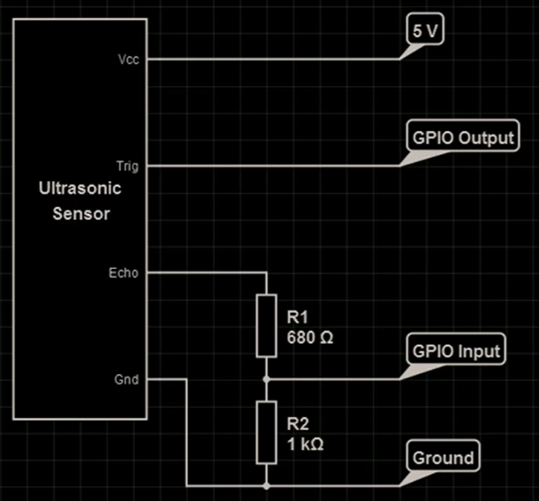
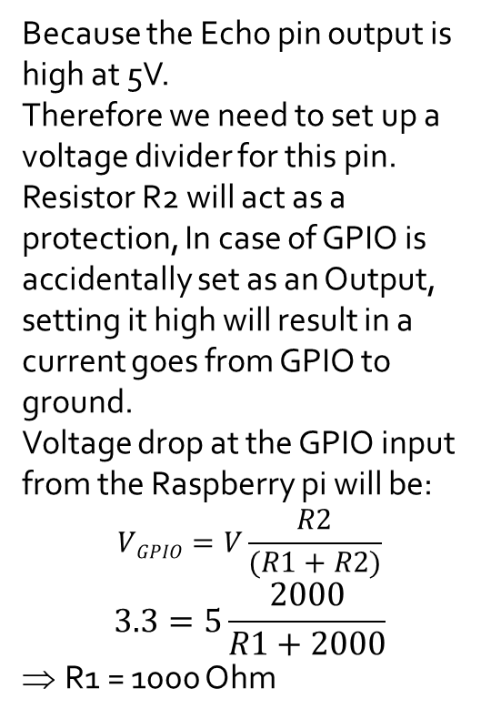
Ultrasonic sensor – Circuit Diagram
Because the Echo pin output is high at 5V.
Therefore we need to set up a voltage divider for this pin.
Resistor R2 will act as a protection, In case of GPIO is accidentally set as an Output, setting it high will result in a current goes from GPIO to ground.
Voltage drop at the GPIO input from the Raspberry pi will be:
$$VGPIO=V\frac{R2}{(R1+R2)}$$
$$3.3=5\frac{2000}{R1+2000}$$
R1 = 1000 Ohm
1k Ω
2k Ω

Slide 11
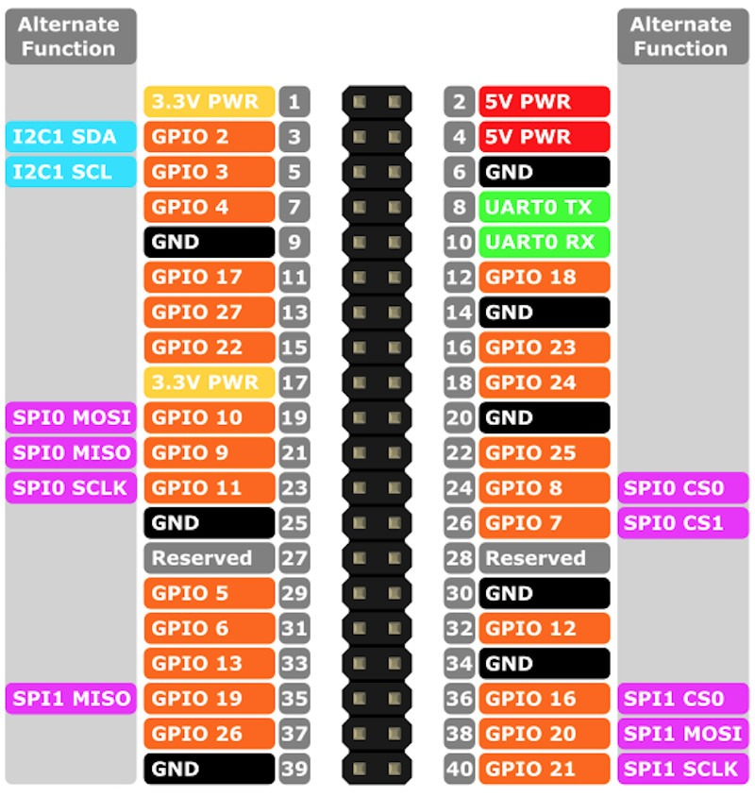
Raspberry Pi 4 – GPIO pinouts
The Raspberry Pi has a 26-pin General Purpose Input/Output (GPIO) connector and this carries a set of signals and buses. There are 8 general purpose digital I/O pins – these can be programmed as either digital outputs or inputs. One of these pins can be designated for PWM output too.
Additionally there is a 2-wire I2C interface and a 4-wire SPI interface (with a 2nd select line, making it 5 pins in total) and the serial UART with a further 2 pins.

Slide 12
Raspberry Pi 4 – WiringPi library
WiringPi is an Arduino wiring-like library written in C and released under the GNU LGPLv3 license which is usable from C and C++ and many other languages with suitable wrappers
You may be familiar with the Arduino… Briefly; Arduino is really two things; one is a hardware platform, the other software, and part of the software is a package called Wiring. Wiring is the core of the input and output for the Arduino, so I thought it would be good to replicate that functionality (or a good usable subset) on the Raspberry Pi.
WiringPi includes a command-line utility gpio which can be used to program and setup the GPIO pins. You can use this to read and write the pins and even use it to control them from shell scripts.

Slide 13
Raspberry Pi 4 – WiringPi installation
Wiring Pi is previously not included with early versions of Raspbian. This required users to download and install it. Luckily, Wiring Pi is included in standard Raspbian systems. If you are looking to update using a mirrored Wiring Pi with small updates to support newer hardware, we recommend checking out this GitHub repository.
Set up GPIO and Wiring library:
Step 1: To check what GPIO version enter the following command.
pi@raspberrypi:~ $ gpio -v gpio version: 2.50 Copyright (c) 2012-2018 Gordon Henderson This is free software with ABSOLUTELY NO WARRANTY. For details type: gpio -warranty Raspberry Pi Details: Type: Unknown17, Revision: 04, Memory: 0MB, Maker: Sony * Device tree is enabled. *--> Raspberry Pi 4 Model B Rev 1.4 * This Raspberry Pi supports user-level GPIO access.

Slide 14
Raspberry Pi 4 – WiringPi installation (cont.)
Step 2: Enter the following to remove the wiringPi and configuration files.
sudo apt-get purge wiringpi
Step 3: Then type the following for the Pi to remove all locations that remember wiringPi.
hash -r
Step 4: As long as you have Git installed, these commands should be all you need to download and install Wiring Pi
git clone https://github.com/WiringPi/WiringPi.git
Step 5: Then enter the following command. The ./build is a script to build Wiring Pi from the source files. This builds the helper files, modifies some paths in Linux and gets WiringPi ready to rock.
./build

Slide 15
Raspberry Pi 4 – WiringPi installation (cont.)
Step 6: At this point, the library should work. Run the gpio command shown below to view some information about the wiringPi version and the Pi that it is running on.
pi@raspberrypi:~/Project/WiringPi $ gpio -v gpio version: 2.60 Copyright (c) 2012-2018 Gordon Henderson This is free software with ABSOLUTELY NO WARRANTY. For details type: gpio -warranty Raspberry Pi Details: Type: Pi 4B, Revision: 04, Memory: 4096MB, Maker: Sony * Device tree is enabled. *--> Raspberry Pi 4 Model B Rev 1.4 * This Raspberry Pi supports user-level GPIO access.
Step 7:Entering the following command will draw a table illustrating the configuration for the pins in the 40-pin connector.
pi@raspberrypi:~/Project/WiringPi $ gpio readall

Slide 16
Raspberry Pi 4 – WiringPi installation (cont.)
pi@raspberrypi:~/Project/WiringPi $ gpio readall +-----+-----+---------+------+---+---Pi 4B--+---+------+---------+-----+-----+ | BCM | wPi | Name | Mode | V | Physical | V | Mode | Name | wPi | BCM | +-----+-----+---------+------+---+----++----+---+------+---------+-----+-----+ | | | 3.3v | | | 1 || 2 | | | 5v | | | | 2 | 8 | SDA.1 | ALT0 | 1 | 3 || 4 | | | 5v | | | | 3 | 9 | SCL.1 | ALT0 | 1 | 5 || 6 | | | 0v | | | | 4 | 7 | GPIO. 7 | IN | 1 | 7 || 8 | 1 | IN | TxD | 15 | 14 | | | | 0v | | | 9 || 10 | 1 | IN | RxD | 16 | 15 | | 17 | 0 | GPIO. 0 | IN | 0 | 11 || 12 | 0 | IN | GPIO. 1 | 1 | 18 | | 27 | 2 | GPIO. 2 | IN | 0 | 13 || 14 | | | 0v | | | | 22 | 3 | GPIO. 3 | IN | 0 | 15 || 16 | 0 | IN | GPIO. 4 | 4 | 23 | | | | 3.3v | | | 17 || 18 | 0 | IN | GPIO. 5 | 5 | 24 | | 10 | 12 | MOSI | IN | 0 | 19 || 20 | | | 0v | | | | 9 | 13 | MISO | IN | 0 | 21 || 22 | 0 | IN | GPIO. 6 | 6 | 25 | | 11 | 14 | SCLK | IN | 0 | 23 || 24 | 1 | IN | CE0 | 10 | 8 | | | | 0v | | | 25 || 26 | 1 | IN | CE1 | 11 | 7 | | 0 | 30 | SDA.0 | IN | 1 | 27 || 28 | 1 | IN | SCL.0 | 31 | 1 | | 5 | 21 | GPIO.21 | IN | 1 | 29 || 30 | | | 0v | | | | 6 | 22 | GPIO.22 | IN | 1 | 31 || 32 | 0 | IN | GPIO.26 | 26 | 12 | | 13 | 23 | GPIO.23 | IN | 0 | 33 || 34 | | | 0v | | | | 19 | 24 | GPIO.24 | IN | 0 | 35 || 36 | 0 | IN | GPIO.27 | 27 | 16 | | 26 | 25 | GPIO.25 | IN | 0 | 37 || 38 | 0 | IN | GPIO.28 | 28 | 20 | | | | 0v | | | 39 || 40 | 0 | IN | GPIO.29 | 29 | 21 | +-----+-----+---------+------+---+----++----+---+------+---------+-----+-----+ | BCM | wPi | Name | Mode | V | Physical | V | Mode | Name | wPi | BCM | +-----+-----+---------+------+---+---Pi 4B--+---+------+---------+-----+-----+

Slide 17
Raspberry Pi 4 – WiringPi API – Set up
On this section we will discuss some of the most useful functions provided by the WiringPi library. It's tailored to look a lot like Arduino, so if you've done any Arduino programming some of this may look familiar.
To begin, you'll need to include the library. At the beginning of your program, type:
#include <wiringPi.h>
After you've included the library, your first steps should be to initialize it. This step also determines which pin numbering scheme you'll be using throughout the rest of your program. Pick one of these function calls to initialize the library:
wiringPiSetup(); // Initializes wiringPi using wiringPi's simlified number system. wiringPiSetupGpio(); // Initializes wiringPi using the Broadcom GPIO pin numbers
WiringPi's simplified number system introduces a third pin-numbering scheme. We didn't show it in the table earlier, if you want to use this scheme, check out their pins page for an overview.

Slide 18
Raspberry Pi 4 – WiringPi API Pin Mode Declaration
To set a pin as either an input or output, use the pinMode([pin], [mode]) function. Mode can be either INPUT, OUTPUT, or PWM_OUTPUT.
For example, to set pin 22 as an input, 23 as an output, and 18 as a PWM, write:
wiringPiSetupGpio() pinMode(17, INPUT); pinMode(23, OUTPUT); pinMode(18, PWM_OUTPUT);
Digital Output
The digitalWrite([pin], [HIGH/LOW]) function can be used to set an output pin either HIGH or LOW. Easy enough, if you're an Arduino user.
To set pin 23 as HIGH, for example, simply call:
digitalWrite(23, HIGH);

Slide 19
Raspberry Pi 4 – WiringPi API Pin Mode Declaration
PWM ("Analog") Output
For the lone PWM pin, you can use pwmWrite([pin], [0-1023]) to set it to a value between 0 and 1024. As an example...will set pin 18 to a duty cycle around 70%.
pwmWrite(18, 723);
Digital Input
To read the digital state of a pin, digitalRead([pin]) is your function. For example...
if (digitalRead(17)) printf("Pin 17 is HIGH\n"); else printf("Pin 17 is LOW\n");
Pull-Up/Down Resistors
Need some pull-up or pull-down resistors on your digital input? Use the pullUpDnControl([pin], [PUD_OFF, PUD_DOWN, PUD_UP]) function to pull your pin.
pullUpDnControl(17, PUD_UP);

Slide 20
Raspberry Pi 4 – WiringPi API Pin Mode Declaration
Delays
WiringPi includes two delay functions to choose from: delay([milliseconds]) and delayMicroseconds([microseconds]).
The standard delay will halt the program flow for a specified number of milliseconds. If you want to delay for 2 seconds, for example, write:
delay(2000);
Or you can use delayMicroseconds() to get a more precise, microsecond-level delay.

Slide 21
Raspberry Pi 4 – WiringPi API Programing
After wring the program, in order compile the code with WiringPI library, we need to use:
To compile our program, we'll invoke gcc. Enter this into your terminal, and wait a second for it to finish compiling, Ex:
gcc -o ouputname codefile.c -l wiringPi
Where the outputname is the name of the excusable file and the codefile.c is the source code file
That command will create an executable file -- “outputname". The "-l wiringPi" part is important, it loads the wiringPi library. A successful compilation won't produce any messages; if you got any errors, try to use the messages to track them down.

Slide 22
Raspberry Pi 4 & Ultrasonic sensor interfacing
After setting up the ultrasonic sensor and the raspberry pi
we can select the GPIO pin from the raspberry pi board to work as the ”trigger” pin and “echo” pin.
From the board we select GPIO 22 and GPIO 27 ( these two pins have been selected because they are single function pin, so we can save other pins for other type of interface)
In the code we can define these pins:
#define TRIG 22 #define ECHO 27

Slide 23
Raspberry Pi 4 & Ultrasonic sensor interfacing
Transfer the code from desktop to raspberry pi. Or you can create the source file directly on raspberry pi by using touch command
~laptop: scp ultrasensor.c pi@192.168.2.33:~/Project
Checking the content of the code by using:
pi@raspberrypi:~/Project $ nano ultrasensor.c
Following pages are the source code: ultrasensor.c

Slide 24
Raspberry Pi 4 & Ultrasonic sensor interfacing
#include <stdio.h> #include <stdlib.h> #include <wiringPi.h> #define TRUE (1==1) // HC-SR04 ultrasonic sensor on Raspberry pi 4 #define TRIG 22 #define ECHO 27 static volatile long startTimeUsec; static volatile long endTimeUsec; double speedOfSoundMetersPerSecond = 340.29; void recordPulseLength() { startTimeUsec = micros(); while (digitalRead(ECHO) == HIGH); endTimeUsec = micros(); }

Slide 25
Raspberry Pi 4 & Ultrasonic sensor interfacing
void setupUltrasonic() { wiringPiSetup(); pinMode(TRIG, OUTPUT); pinMode(ECHO, INPUT); // TRIG pin must start LOW // Initialize the sensor's trigger pin to low. If we don't pause // after setting it to low, sometimes the sensor doesn't work right. digitalWrite(TRIG, LOW); delay(500); // .5 seconds }

Slide 26
Raspberry Pi 4 & Ultrasonic sensor interfacing
int getCM() { // Send trig pulse // Triggering the sensor for 10 microseconds will cause it to send out // 8 ultrasonic (40Khz) bursts and listen for the echos. digitalWrite(TRIG, HIGH); delayMicroseconds(10); digitalWrite(TRIG, LOW); int now = micros(); // Wait for echo start // The sensor will raise the echo pin high for the length of time that it took // the ultrasonic bursts to travel round trip. while (digitalRead(ECHO) == LOW && micros() - now < 30000); recordPulseLength(); long travelTimeUsec = endTimeUsec - startTimeUsec; double distanceMeters = 100 * ((travelTimeUsec / 1000000.0) * 340.29) / 2; //Wait for echo end long startTime = micros(); while (digitalRead(ECHO) == HIGH); long travelTime = micros() - startTime; //Get distance in cm int distance = travelTime * 34000 / 2; return distanceMeters * 100; }

Slide 27
Raspberry Pi 4 & Ultrasonic sensor interfacing
int main(void) { int count = 0; setupUltrasonic(); while (count < 60) { printf("Distance: %dcm\n", getCM()); count++; delay(500); // 0.5 second } return 0; }

Slide 28
Raspberry Pi 4 & Ultrasonic sensor interfacing
Compiling and Executing the code:
By using this command, we can compiling the c code:
pi@raspberrypi:~/Project $ gcc -o ultrasensor ultrasensor.c -l wiringPi
Running the code:
pi@raspberrypi:~/Project $ ./ultrasensor

Slide 29
Raspberry Pi 4 & Ultrasonic sensor interfacing
Result:

Slide 30
Bibliography
Gutierrez, Felipe o. “HC SR04 sensor in C language.” raspberrypi.org, 18 April 2021,
https://www.raspberrypi.org/forums/viewtopic.php?f=33&t=309898&p=1853778#p1853778. Accessed 24 June 2021.
JIMBLOM & MTAYLOR. “Raspberry gPIo.” Learn Sparkfun, https://learn.sparkfun.com/tutorials/raspberry-gpio/all.Accessed 24 June 2021.
“Raspberry Pi 4 Pins – Complete Practical Guide.” The Robotic Back End, https://roboticsbackend.com/raspberry-pi-3-pins/. Accessed 24 June 2021.
WiringPI. “WiringPi.” Github, WiringPi, https://github.com/WiringPi/WiringPi. Accessed 24 June 2021.

